Slide 1




Heart Disease With Data Science
By Jumbo, David, Danielle, and Mohul

Slide 2
Table of Contents
Data Cleaning/ Initial Findings
Our Model
01
02
Model Analysis
Action plans/ Suggestions
03
04
Jumbo/David
Mohul
Jumbo/David
Danielle

Slide 3
About the Dataset
The data used is the Heart Failure Prediction data provided by kaggle
Information of 918 patients
https://www.kaggle.com/fedesoriano/heart-failure-prediction
Explanation of some confusing features names:
RestECG: resting electrocardiographic results
ChestPainType:
ASY: asymptomatic
ATA: atypical angina
NAP: non-anginal pain
TA: typical angina
RestingBP: resting blood pressure
ST_slope: the ST segment shift relative to exercise-induced increments in heart rate
Cholesterol: serum cholesterol
FastingBS: fasting blood sugar
ExerciseAngina: exercise induced angina
Oldpeak: O ST depression induced by exercise relative to rest.
HeartDisease: 1: patient have heart failure
0: patient does not have heart failure

Slide 4
Cleaning & Preparing Data
We created dummy variables for all the categorical variables (‘Sex’, ‘ChestPainType’, ‘Resting ECG’, ‘ExerciseAngina’, and ‘ST_Slope’)
We set the target variable as whether or not someone had Heart Disease
We took out rows with the Cholesterol = 0

Slide 5
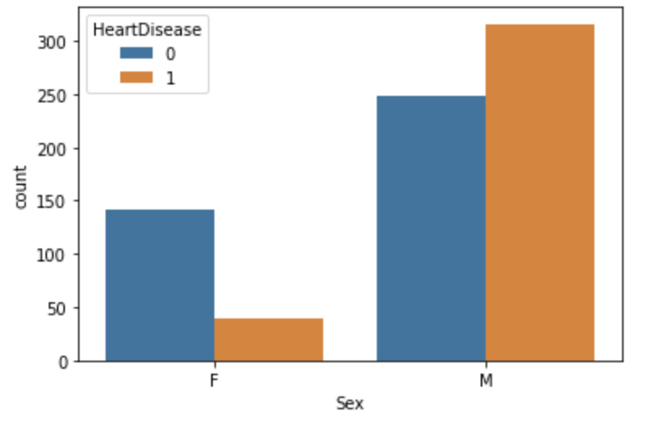
Our Findings (EDA)
In this dataset There are more males than females(potential bias)
Females are less likely to have heart disease than not (75%)
Males are more likely to have heart disease than not (56%)
Potential bias because there’s less number of female cases
Count plot of Male and Female with Heart Disease

Slide 6
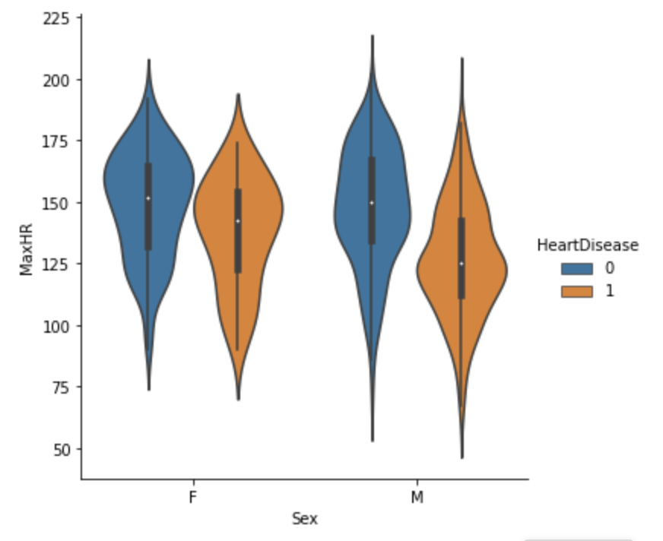
Violin Plot of MAXHR & Sex
Both males and females with higher max heart rate has lower rates of heart disease, especially female
Max HR for males with heart disease is lower than for females with heart disease

Slide 7
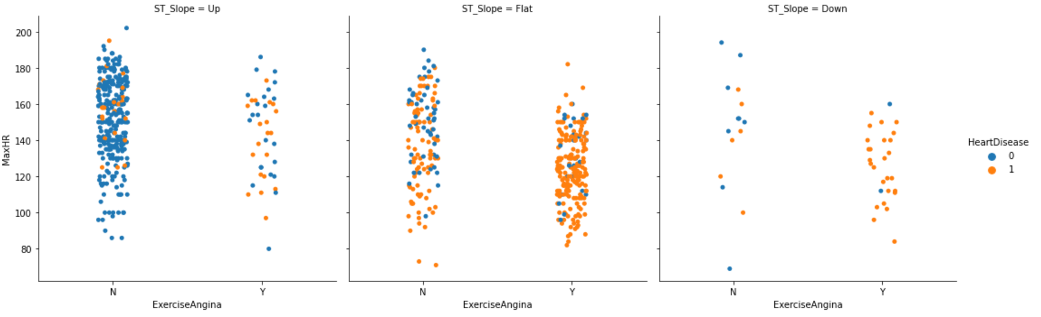
Exercise Angina Vs. ST slope
Those having exercise induced angina seem to have higher rate of heart disease

Slide 8
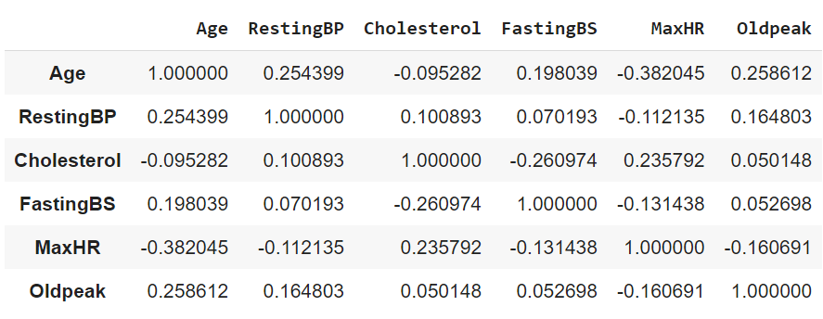
Correlation Matrix
No numerical features are too correlated with each other, highest being |0.38| (age & max heart rate)

Slide 9
Machine Learning Models
Logistic Regression
Support Vector Machines
Random Forest

Slide 10
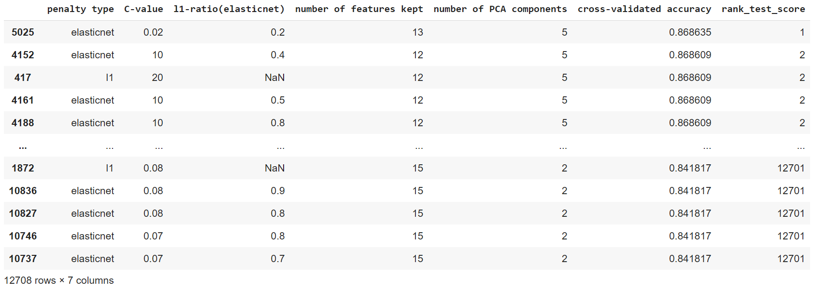
Logistic Regression
With logistic regression, the best result(86.86% accuracy) was achieved with a combination of techniques (ANOVA F-value based feature selection, PCA, K-fold cross validation, GridSearchCV)(12,000 different combination of parameters)
Notes:
So I'm thinking for model: we talk about each model, the resulting accuracy, how we find the best hyper parameters.

Slide 11
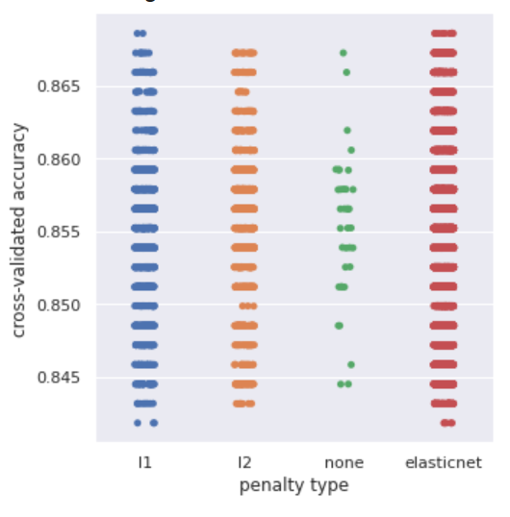
Logistic Regression
Results based on different penalty type used
Elastic net as penalty type for logistic regression wins out by the tiniest margin
Accuracy relatively consistent regardless of of the parameters put int (less than 3% different across the board with more than 12,000 different combination of inputs)
Notes:
So I'm thinking for model: we talk about each model, the resulting accuracy, how we find the best hyper parameters.

Slide 12
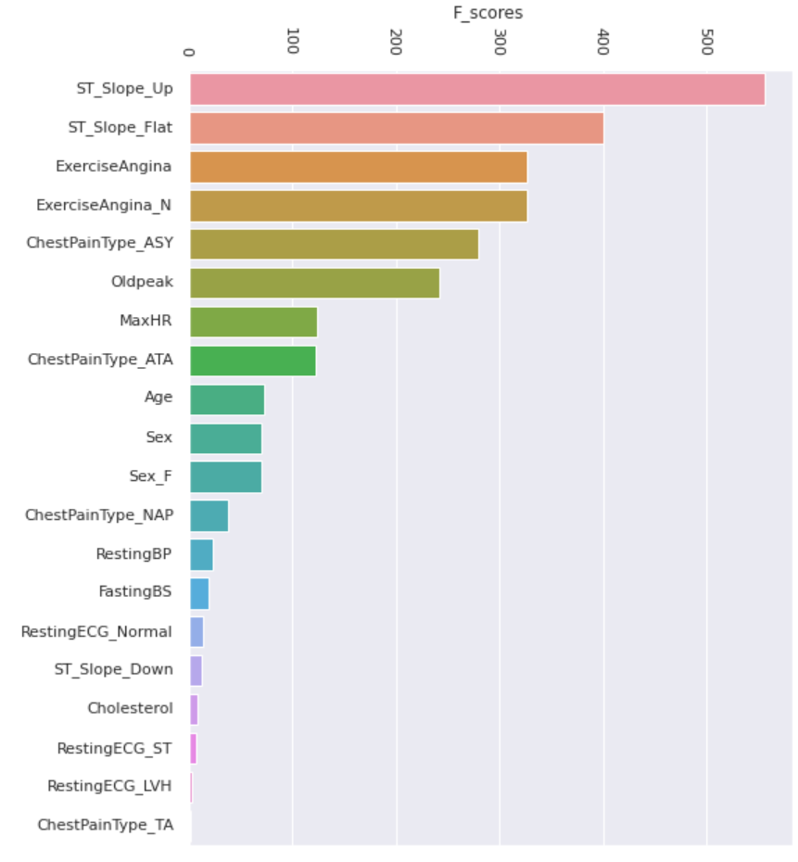
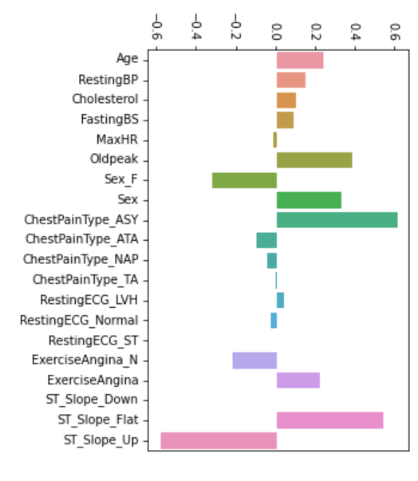
Feature importance: Logistic Regression
Left: The feature importance ranking based on ANOVA F-value (12-13 was kept based on cross-validated results, best performance of 86.86% accuracy (with PCA) )
Buttom: feature importance based on of the coefficients of best performing logistic regression(20 features kept)
Some features are negatively correlated with having heart disease
Notes:
So I'm thinking for model: we talk about each model, the resulting accuracy, how we find the best hyper parameters.

Slide 13
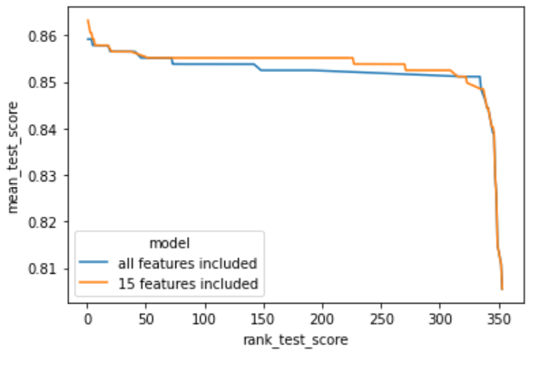
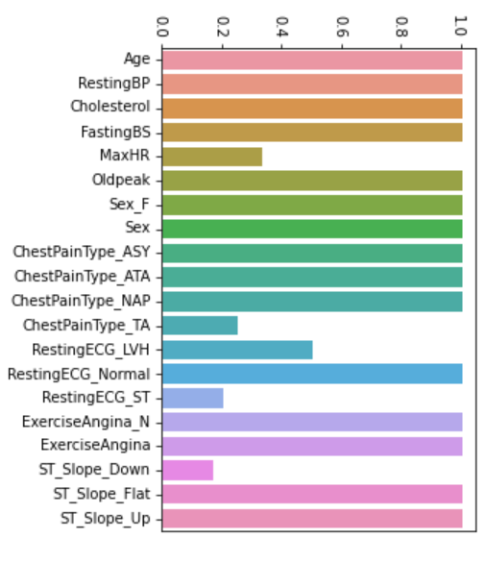
Feature importance:Logistic Regression
RFE
Feature Selection based on Recursive Feature Elimination(RFE): the goal is to select features by recursively considering smaller and smaller sets of features, and eliminate based on the model performance loss/improvement of the each feature eliminated. (accuracy cross-validated)
Feature importance based on ranking of RFECV — 15 features kept to have best accuracy
Notes:
So I'm thinking for model: we talk about each model, the resulting accuracy, how we find the best hyper parameters.

Slide 14
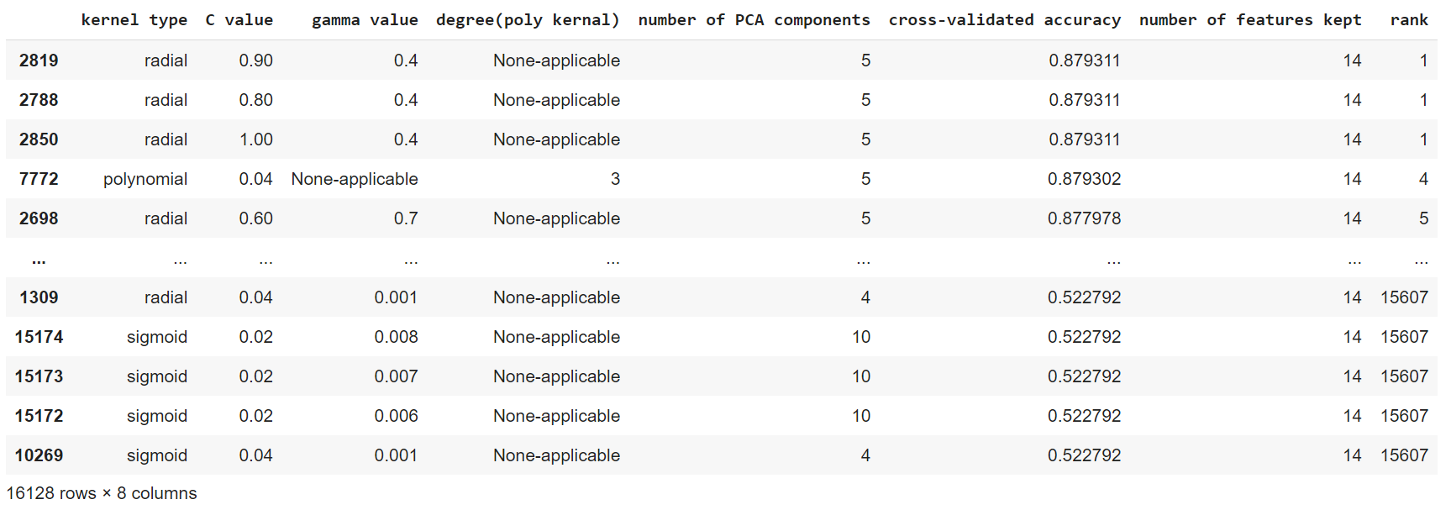
Support Vector Machines
Again, the best results(87.93% accuracy) was achieved with a combination of techniques. (ANOVA F-value based feature selection, PCA, K-fold cross-validation, GridSearchCV)(16,000 combination of parameter inputs)

Slide 15
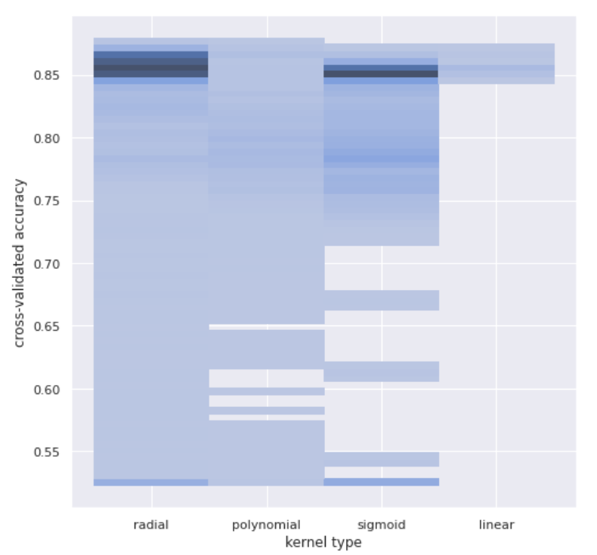
Support Vector Machines
Accuracy varies drastically depending on the parameter, from around 52% to 87.93%, except for linear kernels
Radial kernels wins out by also tiniest margin

Slide 16
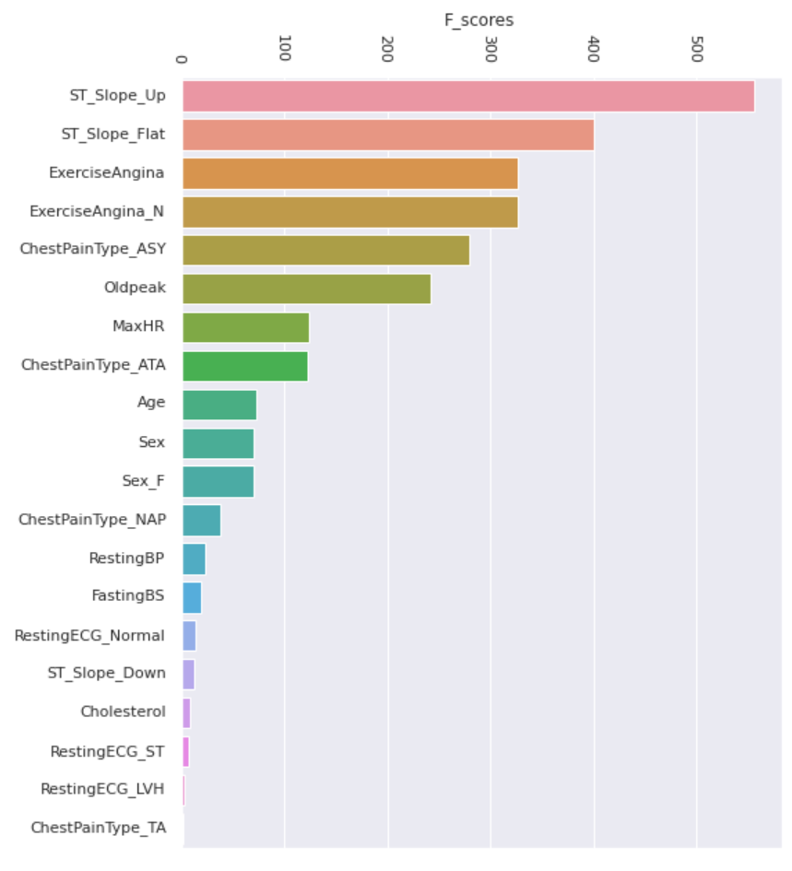
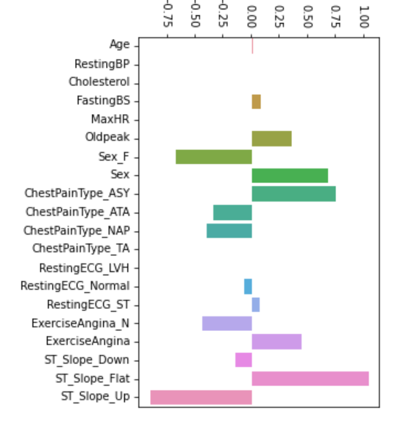
Feature importance: Support Vector Machines
Left: the best model performance was achieved(87.93%) when the top 14 features was kept(with PCA)
Bottom: feature importance based on coefficients of the best performing linear SVM model

Slide 17
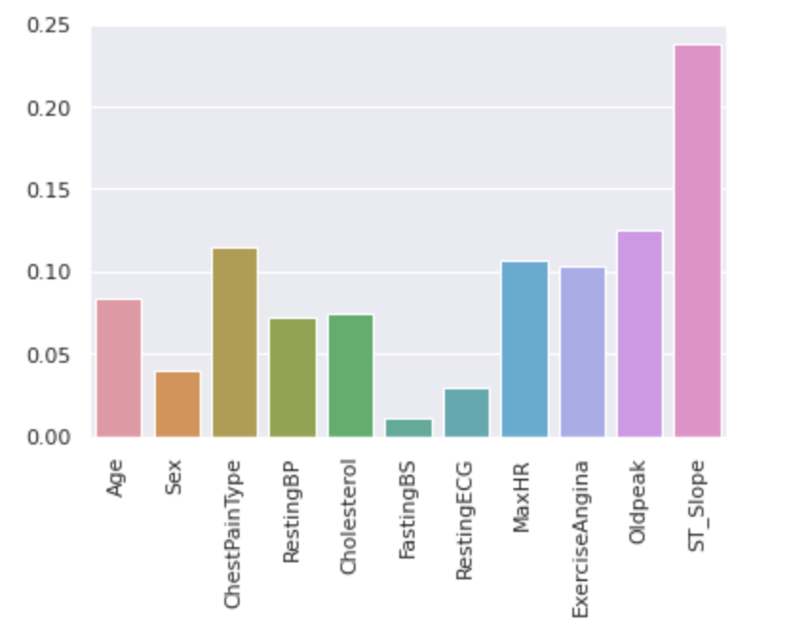
Random Forest
Cross Validation
Out of Bag Sample
Barplot of Feature Selected Values
What is it? Used to assess how this model would do in new data
N Estimators = 241
CV = 7
Accuracy = 0.87
ROC AUC = 0.92
What is it? A very powerful validation technique used for Random Forest for least variance
Result = 0.861

Slide 18
Ranking Accuracy Rate
87.93%
87%
86.86%
Support Vector Machines
Random Forest
Logistic Regression
Very small margins!

Slide 19
Our Ranking of Models
2.
Logistic regression
Random Forest
Support Vector Machines
Accuracy slightly less than the others by very small margin. However, it is much simpler and interpretable
High accuracy, but more complex
Highest accuracy achieved, but less interpretable

Slide 20
Feature Importance: Overall
Logistic regression
F-value based feature ranking
Support Vector Machines
Random Forest
Across all models these features stands out as the most influential/important to accurately predicting heart disease( )
ST slope: the strongest predictor, an upward/flat slope are very
negatively/positively correlated with having heart disease
Chest pain type: Asymptomatic chest pain type in particular is a
strong predictor of having heart disease
Exercise induced angina: having no exercise induced angina is correlated with Not having heart disease
Oldpeak: positively correlated with having heart disease
While the absence of these features actually boost the performance of models ( )
Fasting blood sugar
Resting ECG
Resting blood pressure
Downward ST slope
Typical angina chest pain type
Surprisingly, Cholesterol level
Due to low number of cases in the data

Slide 21
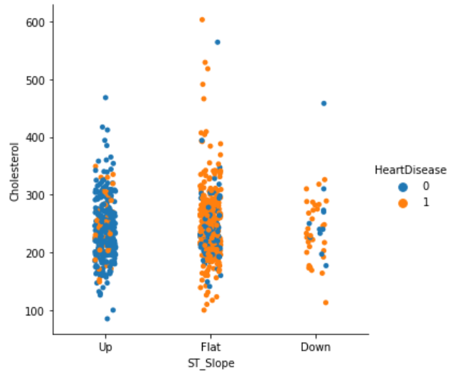
Why cholesterol as a feature is insignificant?
Categorical plot of ST_Slope & Cholesterol
ST slope is by far the strongest predictor of heart disease
However when cholesterol is plot, most cases with and without heart disease are all jumbled together.
An increase in cholesterol level does not seem to be strongly correlated with heart disease, except for few cases in “Flat” ST slope

Slide 22
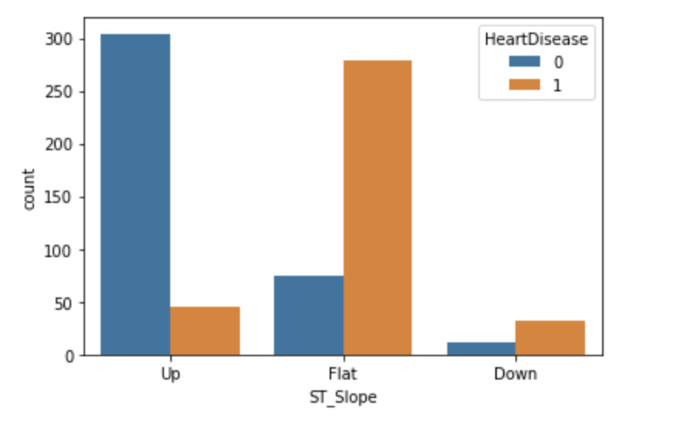
ST Slope
Countplot of ST_SLope
Flat ST_Slope has the highest percentage of having an heart disease (82.8%)
ST_Slope Down has a percentage of having an heart disease (77.7%), but low number of cases
ST_Slope Up has the lowest percentage of having an heart disease (19.7%)

Slide 23
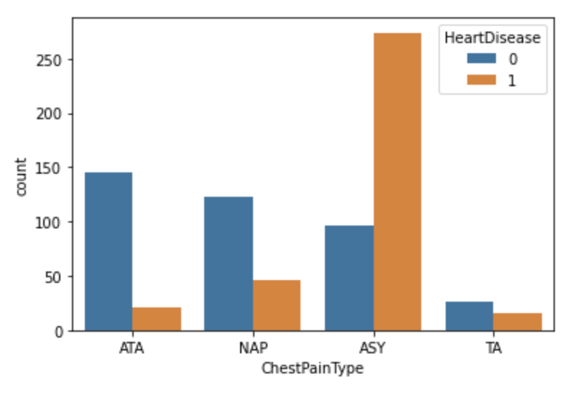
Chest Pain Type
Countplot of ChestPainType
ASY has the highest percentage of having a heart disease among the rest (47.90%)
ATA has the lowest percentage of having a heart disease (13.9%)
ATA has a percentage of 3.53% for having a heart disease
TA has a percentage of 43.5% for having a heart disease, but low number of total cases.

Slide 24
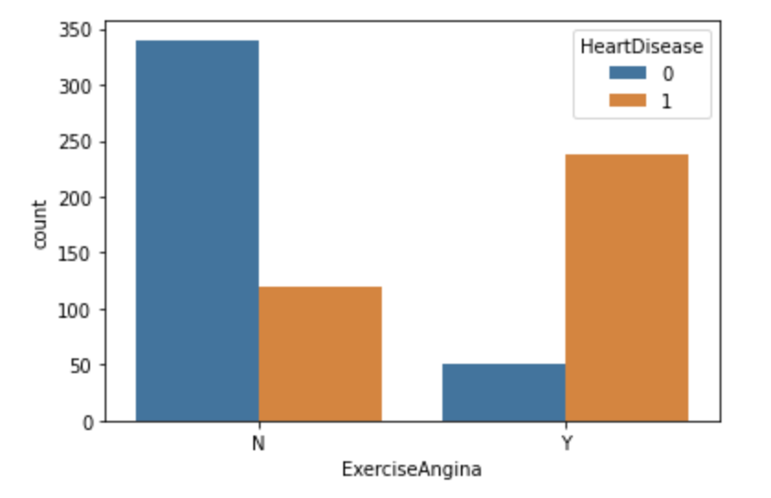
Exercise Angina
Countplot of Exercise Angina
N_Exercise Angina has a percentage of 35.1% for having heart disease
Y_Exercise Angina has a percentage of 85.2% for having heart disease
This supports the feature selection that Y_Exercise does have a significant impact on Exercise Angina

Slide 25
Model-Based Information and Recommendations
ST Slope over exercise-induced increments in heart rate can be a strong predictor of coronary artery disease (CAD)
The most common cause of ST segment abnormality is myocardial ischaemia (when blood flow to the heart is obstructed, could lead to heart attack)
Some solutions:
Make heart-healthy choices
Maintaining a healthy body weight

Slide 26
Model-Based Information and Recommendations
Those who respond ‘Yes’ to experiencing exercise angina are more likely to develop heart diseases
Angina can be a warning sign of heart problems
Be sure to consult a doctor if you experience this
Some solutions:
Balance your diet
Build up activity level gradually

Slide 27
Thanks!
Do you have any questions?
Thankyou Miguel & Enock for this wonderful IX Winter Bootcamp. We wish you the best of luck :D
Special thanks to Cordene & Lize for attending this event :D

Slide 28
Heart Health and CVD Prevention
Maintain a healthy diet full of fruits and vegetables and low in sodium and saturated/unhealthy fats
Exercise for at least 150 minutes every week
Avoid smoking and secondhand smoke
Manage stress with things like aromatherapy and meditation
Control cholesterol and blood pressure

